Slide 1

Custom Action Filters in ASP.NET MVC

Slide 2



































TITANIUM SPONSORS
Platinum Sponsors
Gold Sponsors

Slide 3
What are action filters?
An attribute that can be applied to an individual action method on a controller, or to the entire controller.

Slide 4
Filter Types
Authorize
Action
Result
Exception

Slide 5
Built-in Filter Attributes
Authorize
ValidateInput
RequireHttps
HandleError
OutputCache

Slide 6
Authorize
IActionFilter
FilterAttribute
IResultFilter
HandleError
IAuthorizationFilter
RequireHttps
ValidateInput
OutputCache
ActionFilterAttribute
IExceptionFilter

Slide 7
Authorize
IActionFilter
FilterAttribute
IResultFilter
HandleError
IAuthorizationFilter
RequireHttps
ValidateInput
OutputCache
ActionFilterAttribute
IExceptionFilter

Slide 8
Authorize
IActionFilter
FilterAttribute
IResultFilter
HandleError
IAuthorizationFilter
RequireHttps
ValidateInput
OutputCache
ActionFilterAttribute
IExceptionFilter

Slide 9
Built-in Filter Attributes
Authorize
ValidateInput
RequireHttps
HandleError
OutputCache

Slide 10
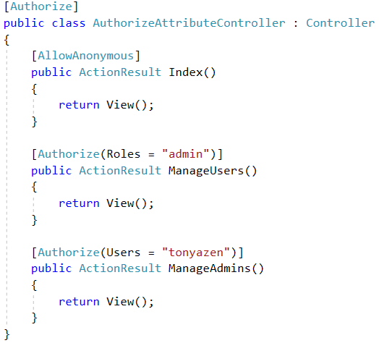

Slide 11
Built-in Filter Attributes
Authorize
ValidateInput
RequireHttps
HandleError
OutputCache

Slide 12

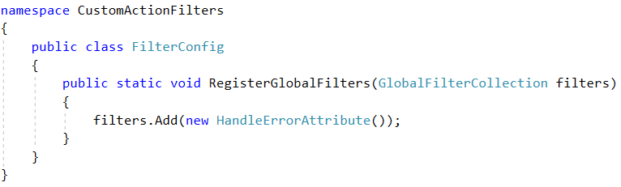
Turn on custom errors in Web.config:
FilterConfig.cs

Slide 13
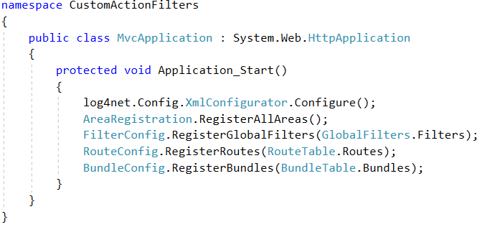
Global.asax

Slide 14
Built-in Filter Attributes
Authorize
ValidateInput
RequireHttps
HandleError
OutputCache

Slide 15
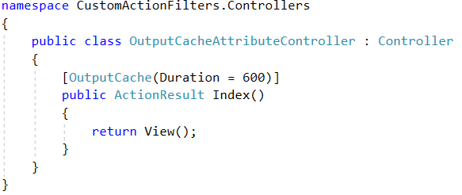

Slide 16
Built-in Filter Attributes
Authorize
ValidateInput
RequireHttps
HandleError
OutputCache

Slide 17
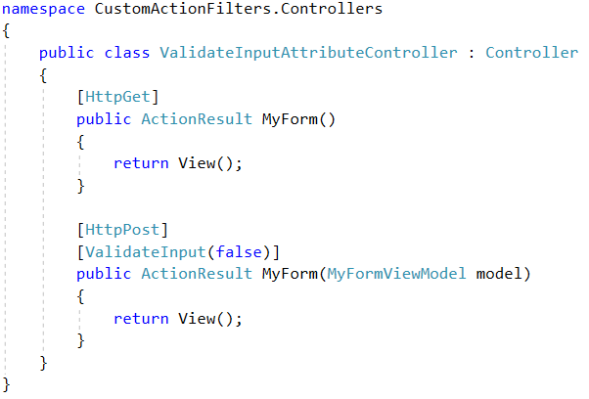

Slide 18
Built-in Filter Attributes
Authorize
ValidateInput
RequireHttps
HandleError
OutputCache

Slide 19
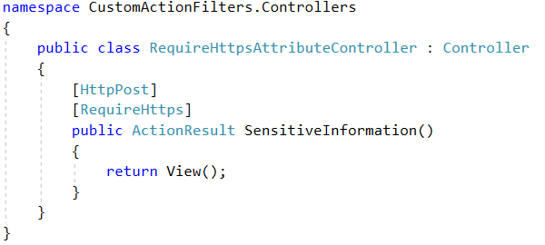

Slide 20
Custom Filters
Share code across action methods
Share code across controllers
Custom exception handling
Logging
Modify responses
Save responses

Slide 21
ActionFilterAttribute
Override Methods:
OnActionExecuting
OnActionExecuted
OnResultExecuting
OnResultExecuted

Slide 22
Action Filters…
In Action

Slide 23
Start Filtering
Name your filters appropriately

Slide 24
CustomFilter is NOT a good name.

Slide 25
Start Filtering
Name your filters appropriately
Apply to one or more action

Slide 26
Start Filtering
Name your filters appropriately
Apply to one or more action
Apply to one or more controller

Slide 27
Start Filtering
Name your filters appropriately
Apply to one or more action
Apply to one or more controller
Apply globally

Slide 28
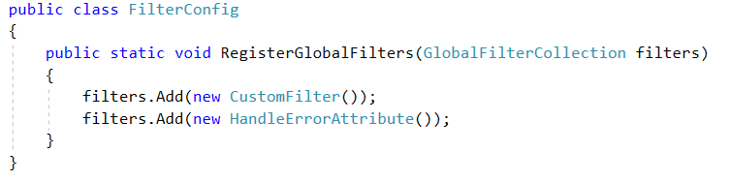
FilterConfig.cs

Slide 29
Start Filtering
Name your filters appropriately
Apply to one or more action
Apply to one or more controller
Apply globally
Specify the order

Slide 30
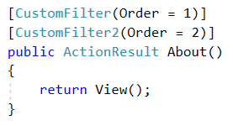

Slide 31
Custom Action Filters in ASP.NET MVC

